Slide 1
PRESENTING PROBLEMS IN CARDIOVASCULAR DISEASE

Slide 2
Cardiovascular disease gives rise to a relatively limited range of symptoms.
Differential diagnosis depends on careful analysis of the factors that provoke symptoms, the subtle differences in how they are described by the patient, the clinical findings and appropriate investigations.
A close relationship between symptoms and exercise is the hallmark of heart disease.

Slide 3
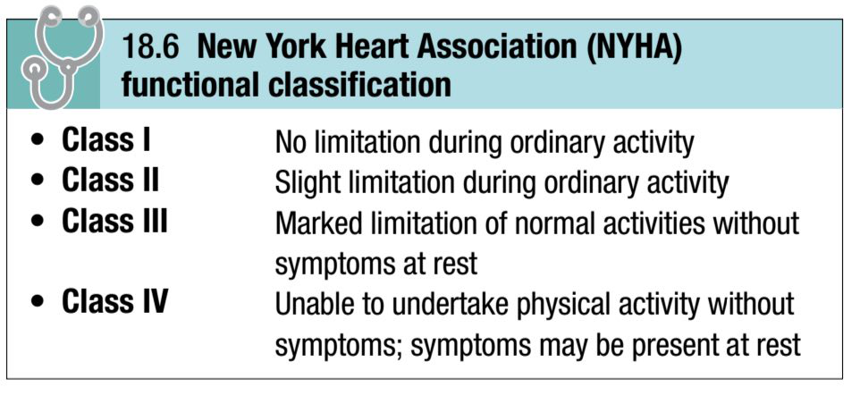
The New York Heart Association (NYHA) functional classification is used to grade disability:

Slide 4
CHEST PAIN

Slide 5
Chest pain is a common presentation of cardiac disease but can also be a manifestation of anxiety or disease of the lungs or musculoskeletal or gastrointestinal systems.
Some patients deny ‘pain’ in favour of ‘discomfort’ but the significance remains the same.

Slide 6
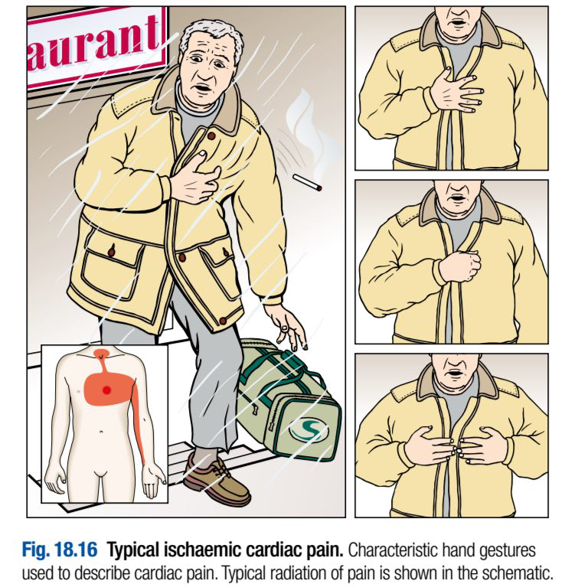
Characteristics of ischaemic cardiac pain
Several key characteristics help to distinguish cardiac pain from that of other causes.

Slide 7
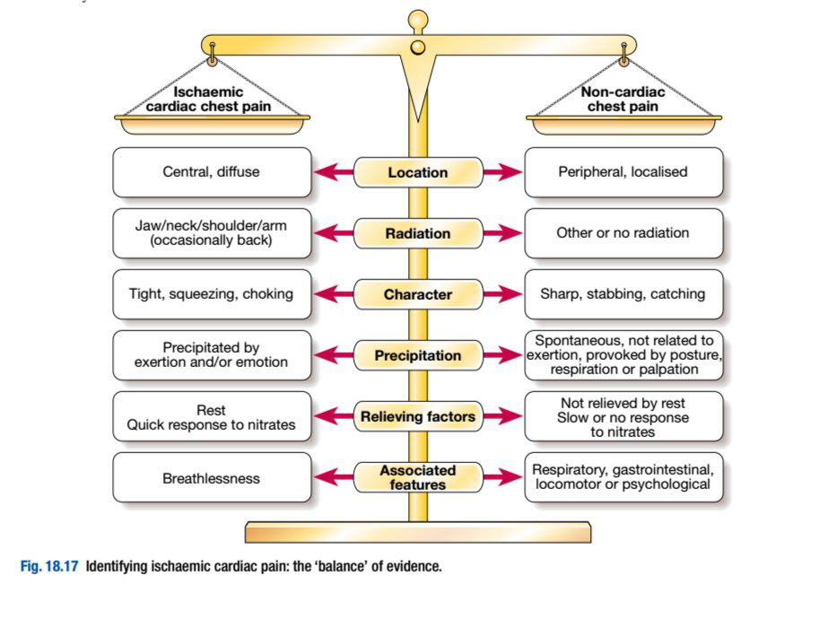
Diagnosis may be difficult and it is helpful to classify pain as possible, probable or definite ischaemic cardiac pain, based on the balance of evidence, as in this figure:

Slide 8
-Site: Cardiac pain is typically located in the centre of the chest because of the derivation of the nerve supply to the heart and mediastinum.

Slide 9
-Radiation: Ischaemic cardiac pain may radiate to the neck, jaw, and upper or even lower arms.
Occasionally, cardiac pain may be experienced only at the sites of radiation or in the back.
Pain situated over the left anterior chest and radiating laterally is unlikely to be due to cardiac ischaemia and may have many causes including pleural or lung disorders, musculoskeletal problems and anxiety.

Slide 10
-Character: Cardiac pain is typically dull, constricting, choking or ‘heavy’, and is usually described as squeezing, crushing, burning or aching but not sharp, stabbing, pricking or knife-like.
The sensation can be described as breathlessness. Patients often emphasise that it is a discomfort rather than a pain.
They typically use characteristic hand gestures (e.g. open hand or clenched fist) when describing ischaemic pain.

Slide 11
-Provocation: Anginal pain occurs during (not after) exertion and is promptly relieved (in less than 5 minutes) by rest.
The pain may also be precipitated or exacerbated by emotion but tends to occur more readily during exertion, after a large meal or in a cold wind.

Slide 12
In crescendo or unstable angina, similar pain may be precipitated by minimal exertion or at rest.
The increase in venous return or preload induced by lying down may also be sufficient to provoke pain in vulnerable patients (decubitus angina).

Slide 13
The pain of MI may be preceded by a period of stable or unstable angina but may occur de novo.
In contrast, pleural or pericardial pain is usually described as a ‘sharp’ or ‘catching’ sensation that is exacerbated by breathing, coughing or movement.
Pain associated with a specific movement (bending, stretching, turning) is likely to be musculoskeletal in origin.

Slide 14
-Onset: The pain of MI typically takes several minutes or even longer to develop; similarly, angina builds up gradually in proportion to the intensity of exertion.
Pain that occurs after rather than during exertion is usually musculoskeletal or psychological in origin.
The pain of aortic dissection, massive pulmonary embolism or pneumothorax is usually very sudden or instantaneous in onset.

Slide 15
-Associated features: The pain of MI, massive pulmonary embolism or aortic dissection is often accompanied by autonomic disturbance including sweating, nausea and vomiting.
Breathlessness, due to pulmonary congestion arising from transient ischaemic left ventricular dysfunction, is often a prominent and occasionally the dominant feature of MI or angina (angina equivalent).

Slide 16
Breathlessness may also accompany any of the respiratory causes of chest pain and can be associated with cough, wheeze or other respiratory symptoms.
Classical gastrointestinal symptoms, such as oesophageal reflux, oesophagitis, peptic ulceration or biliary disease, may indicate noncardiac chest pain but effort-related ‘indigestion’ is usually due to heart disease.

Slide 17
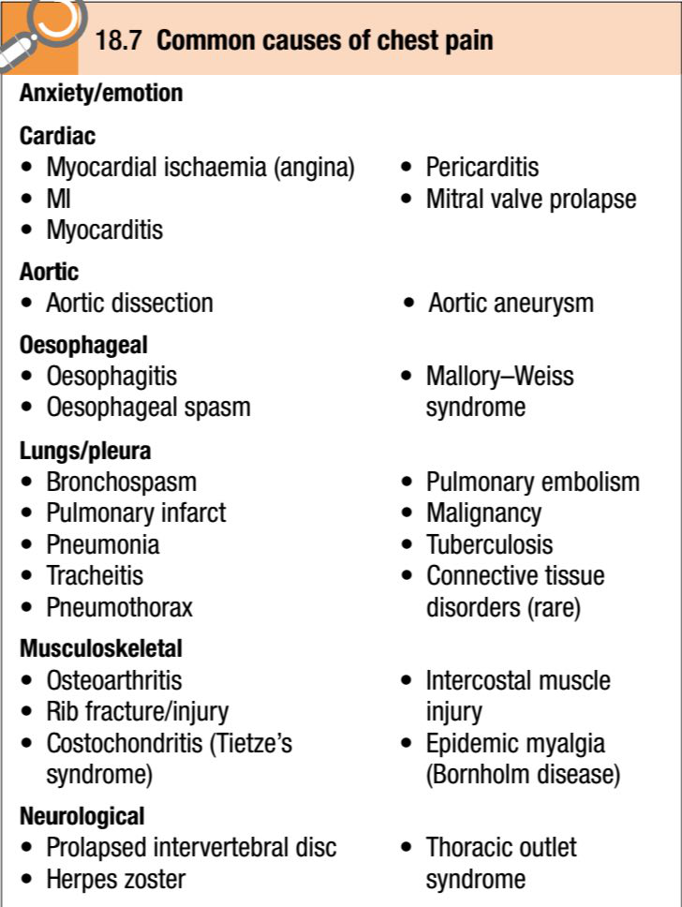
Differential diagnosis of chest pain

Slide 18
:- Psychological aspects of chest pain
Emotional distress is a common cause of atypical chest pain.
This diagnosis should be considered if there are features of anxiety and the pain lacks a predictable relationship with exercise.
However, the prospect of heart disease is a frightening experience, particularly when it has been responsible for the death of a close friend or relative; psychological and organic features therefore often coexist.

Slide 19
Anxiety may amplify the effects of organic disease and can create a very confusing picture.
Patients who believe they are suffering from heart disease are sometimes afraid to take exercise and this may make it difficult to establish their true effort tolerance; assessment may also be complicated by the impact of physical deconditioning.

Slide 20
-Myocarditis and pericarditis:
Pain is characteristically felt retrosternally, to the left of the sternum, or in the left or right shoulder, and typically varies in intensity with movement and the phase of respiration.
The pain is usually described as ‘sharp’ and may ‘catch’ the patient during inspiration, coughing or lying flat; there is occasionally a history of a prodromal viral illness.

Slide 21
:-Mitral valve prolapse
Sharp left-sided chest pain that is suggestive of a musculoskeletal problem may be a feature of mitral valve prolapse.

Slide 22
:-Aortic dissection
This pain is severe, sharp and tearing, is often felt in or penetrating through to the back, and is typically very abrupt in onset.
The pain follows the path of the dissection.

Slide 23
-Oesophageal pain:
This can mimic the pain of angina very closely, is sometimes precipitated by exercise and may be relieved by nitrates.
However, it is usually possible to elicit a history relating chest pain to supine posture or eating, drinking or oesophageal reflux.
It often radiates to the back.

Slide 24
:-Bronchospasm
Patients with reversible airways obstruction, such as asthma, may describe exertional chest tightness that is relieved by rest.
This may be difficult to distinguish from ischaemic chest tightness. Bronchospasm may be associated with wheeze, atopy and cough.

Slide 25
-Musculoskeletal chest pain:
This is a common problem that is very variable in site and intensity but does not usually fall into any of the patterns described above.
The pain may vary with posture or movement of the upper body and is sometimes accompanied by local tenderness over a rib or costal cartilage.

Slide 26
There are numerous causes, including arthritis, costochondritis, intercostal muscle injury and Coxsackie viral infection (epidemic myalgia or Bornholm disease).
Many minor soft tissue injuries are related to everyday activities such as driving, manual work and sport.

Slide 27
Initial evaluation of suspected cardiac pain
A careful history is crucial in determining whether pain is cardiac or not.
Although the physical findings and subsequent investigations may help to confirm the diagnosis, they are of more value in determining the nature and extent of any underlying heart disease, the risk of a serious adverse event, and the best course of management.

Slide 28
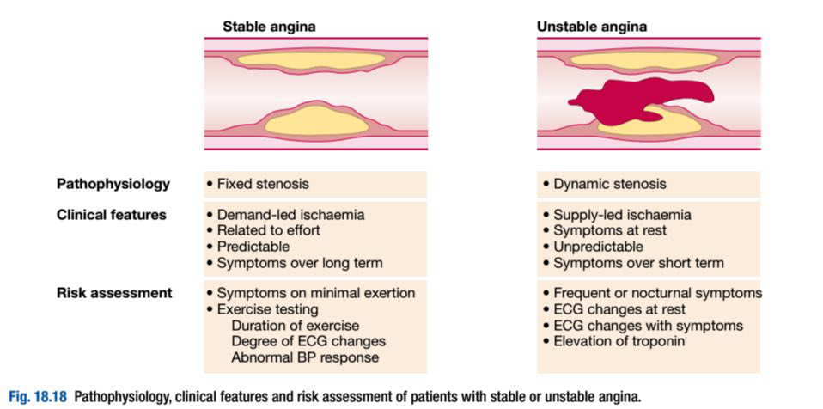
-Stable angina:
Effort-related chest pain is the hallmark of stable angina.

Slide 29
The reproducibility, predictability and relationship to physical exertion (and occasionally emotion) of the chest pain are the most important features.
The duration of symptoms should be noted because patients with recent-onset angina are at greater risk than those with long-standing and unchanged symptoms.

Slide 30
Physical examination is often normal but may reveal evidence of risk factors (e.g. xanthoma indicating hyperlipidaemia), left ventricular dysfunction (e.g. dyskinetic apex beat, gallop rhythm), other manifestations of arterial disease (e.g. bruits, signs of peripheral vascular disease) and unrelated conditions that may exacerbate angina (e.g. anaemia, thyroid disease).

Slide 31
Stable angina is usually a symptom of coronary artery disease but may be a manifestation of other forms of heart disease, particularly aortic valve disease and hypertrophic cardiomyopathy.
In patients with angina in whom a murmur is found, echocardiography should be performed.

Slide 32
A full blood count, fasting blood glucose, lipids, thyroid function tests and a 12-lead ECG are the most important baseline investigations.
Exercise testing may help to confirm the diagnosis and is also used to identify high-risk patients who require further investigation and treatment.

Slide 33
-Acute coronary syndromes:
Prolonged and severe cardiac chest pain may be due to unstable angina (which comprises recent-onset limiting angina, rapidly worsening or crescendo angina, and angina at rest) or acute MI; these are known collectively as the acute coronary syndromes.

Slide 34
Although there may be a history of antecedent chronic stable angina, an episode of chest pain at rest is often the first presentation of coronary disease.
The diagnosis depends on analysis of the character of the pain and its associated features. Physical examination may reveal signs of important comorbidity, such as peripheral or cerebrovascular disease, autonomic disturbance (such as pallor or sweating) and complications (such as arrhythmia or heart failure).

Slide 35
Patients presenting with symptoms consistent with an acute coronary syndrome require urgent evaluation because there is a high risk of avoidable complications, such as sudden death and MI.
Signs of haemodynamic compromise (hypotension, pulmonary oedema), ECG changes (ST segment elevation or depression) and biochemical markers of cardiac damage, such as elevated troponin I or T, are powerful indicators of short-term risk.

Slide 36
A 12-lead ECG is mandatory and is the most useful method of initial triage.
The release of markers such as creatine kinase, troponin and myoglobin is relatively slow but can help guide immediate management and treatment.

Slide 37
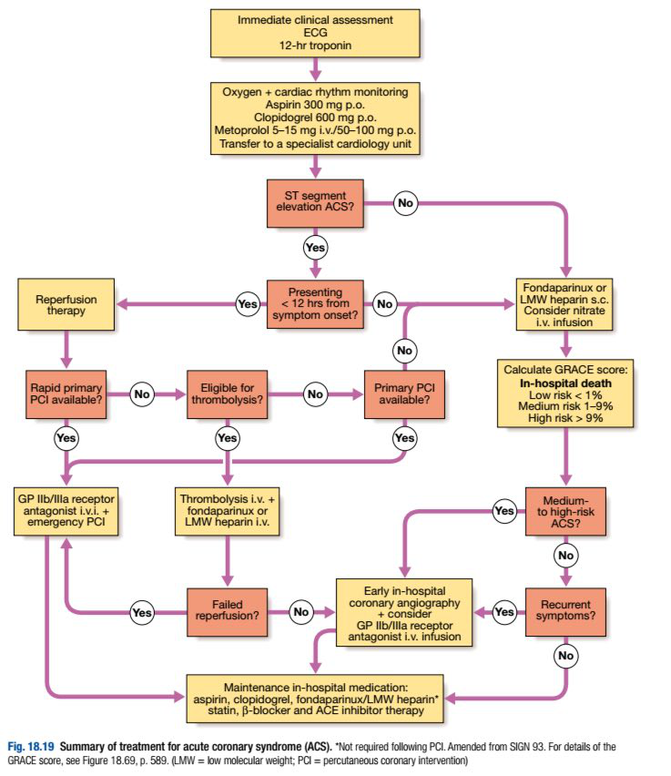

Slide 38
If the diagnosis is unclear, patients with a suspected acute coronary syndrome should be observed in hospital.
Repeated ECG recordings are valuable, particularly if obtained during an episode of pain.
Plasma troponin concentrations should be measured and, if normal, repeated 12 hours after the onset of symptoms or hospital admission.

Slide 39
New ECG changes or an elevated plasma troponin concentration confirm the diagnosis of an acute coronary syndrome.
If the pain has not recurred 12 hours after the onset of symptoms, plasma troponin concentrations are not elevated and there are no new ECG changes, the patient may be discharged from hospital. At this stage, an exercise test may help to diagnose underlying coronary heart disease but does not reliably exclude the future risk of MI.

Slide 40
BREATHLESSNESS
( DYSPNEA )

Slide 41
Dyspnoea of cardiac origin may vary in severity from an uncomfortable awareness of breathing to a frightening sensation of ‘fighting for breath’.
The sensation of dyspnoea originates in the cerebral cortex.

Slide 42
There are several causes of cardiac dyspnoea: acute left heart failure, chronic heart failure, arrhythmia and angina equivalent.

Slide 43
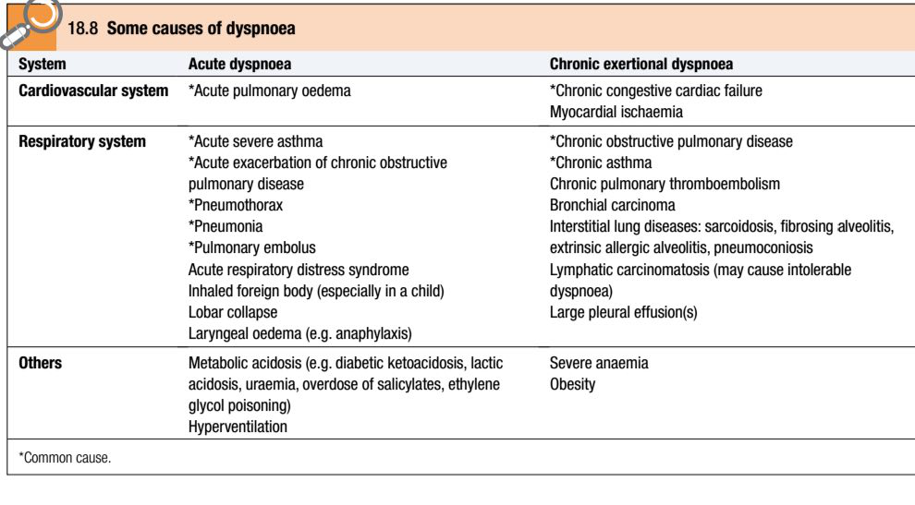

Slide 44
Acute left heart failure
Acute left heart failure may be triggered by a major event such as MI in a previously healthy heart, or by a relatively minor event such as the onset of atrial fibrillation in a diseased heart.
An increase in the left ventricular diastolic pressure causes the pressure in the LA, pulmonary veins and pulmonary capillaries to rise.

Slide 45
When the hydrostatic pressure of the pulmonary capillaries exceeds the oncotic pressure of plasma (about 25–30mmHg), fluid moves from the capillaries into alveoli.
This stimulates respiration through a series of autonomic reflexes, producing rapid shallow respiration. Congestion of the bronchial mucosa may cause wheeze (cardiac asthma).

Slide 46
Acute pulmonary oedema is a terrifying experience with the sensation of ‘fighting for breath’.
Sitting upright or standing may provide some relief by helping to reduce congestion at the apices of the lungs.
The patient may be unable to speak and is typically distressed, agitated, sweaty and pale.

Slide 47
Respiration is rapid with recruitment of accessory muscles, coughing and wheezing. Sputum may be profuse, frothy and blood-streaked or pink.
Extensive crepitations and rhonchi are usually audible in the chest and there may also be signs of right heart failure.

Slide 48
Chronic heart failure
Chronic heart failure is the most common cardiac cause of chronic dyspnoea.
Symptoms may first present on moderate exertion, such as walking up a steep hill, and may be described as a difficulty in ‘catching my breath’.

Slide 49
As heart failure progresses, the dyspnoea is provoked by less exertion and ultimately the patient may be breathless walking from room to room, washing, dressing or trying to hold a conversation.

Slide 50
Other symptoms may include:
-Orthopnoea: Lying down increases the venous return to the heart and provokes breathlessness. Patients may prop themselves up with pillows to prevent this.

Slide 51
-Paroxysmal nocturnal dyspnoea:
In patients with severe heart failure, fluid shifts from the interstitial tissues of the peripheries into the circulation within 1–2 hours of lying down.
Pulmonary oedema supervenes, causing the patient to wake and sit upright, profoundly breathless.

Slide 52
-Cheyne–Stokes respiration:
This cyclical pattern of respiration is due to impaired responsiveness of the respiratory centre to carbon dioxide and occurs in severe left ventricular failure.
The pattern of slowly diminishing respiration, leading to apnoea, followed by progressively increasing respiration and hyperventilation, may be accompanied by a sensation of breathlessness and panic during the period of hyperventilation.

Slide 53
The Cheyne–Stokes cycle length is a function of the circulation time.
The condition can also occur in diffuse cerebral atherosclerosis, stroke or head injury, and may be exaggerated by sleep, barbiturates and opiates.

Slide 54
Arrhythmia
Any arrhythmia may cause breathlessness but usually does so only if the heart is structurally abnormal, such as with the onset of atrial fibrillation in a patient with mitral stenosis.

Slide 55
Angina equivalent
Breathlessness is a common feature of angina.
Patients will sometimes describe chest tightness as ‘breathlessness’.
However, myocardial ischaemia may also induce true breathlessness by provoking transient left ventricular dysfunction or heart failure.

Slide 56
When breathlessness is the dominant or sole feature of myocardial ischaemia, it is known as ‘angina equivalent’.
A history of chest tightness, the close correlation with exercise, and objective evidence of myocardial ischaemia from stress testing may all help to establish the diagnosis.

Slide 57
ACUTE CIRCULATORY FAILURE
( CARDIOGENIC SHOCK )

Slide 58
‘Shock’ is used to describe the clinical syndrome that develops when there is critical impairment of tissue perfusion due to some form of acute circulatory failure.

Slide 59
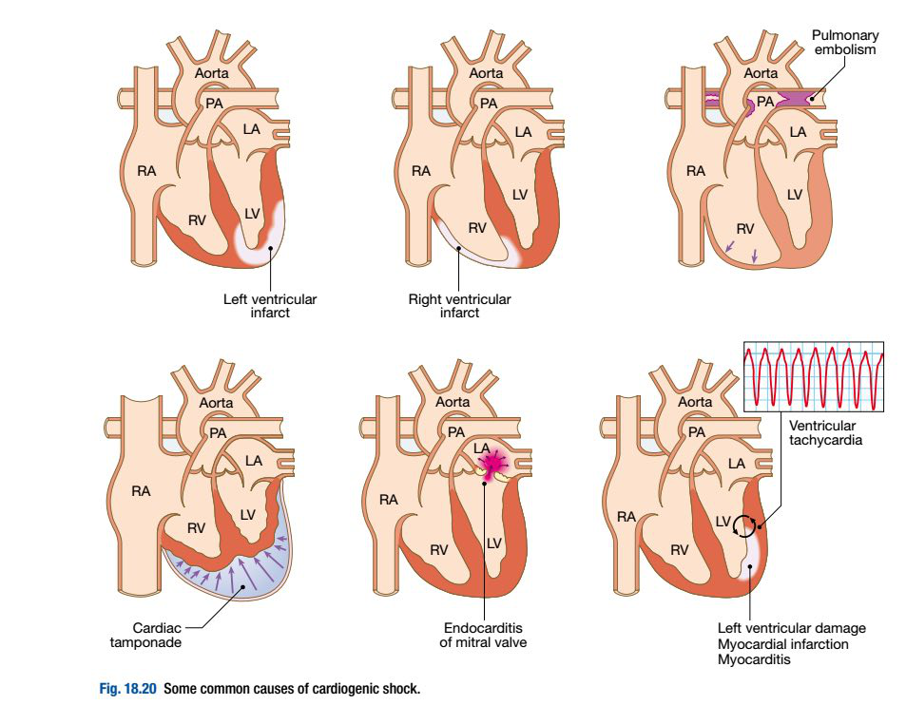
Causes:

Slide 60
-Myocardial infarction:
Shock in acute MI is due to left ventricular dysfunction in more than 70% of cases.
However, it may also be due to infarction of the RV and a variety of mechanical complications, including tamponade (due to infarction and rupture of the free wall), an acquired ventricular septal defect (due to infarction and rupture of the septum) and acute mitral regurgitation (due to infarction or rupture of the papillary muscles).

Slide 61
Severe myocardial systolic dysfunction causes a fall in cardiac output, BP and coronary perfusion pressure.
Diastolic dysfunction causes a rise in left ventricular end-diastolic pressure, pulmonary congestion and oedema, leading to hypoxaemia that worsens myocardial ischaemia.
This is further exacerbated by peripheral vasoconstriction.

Slide 62
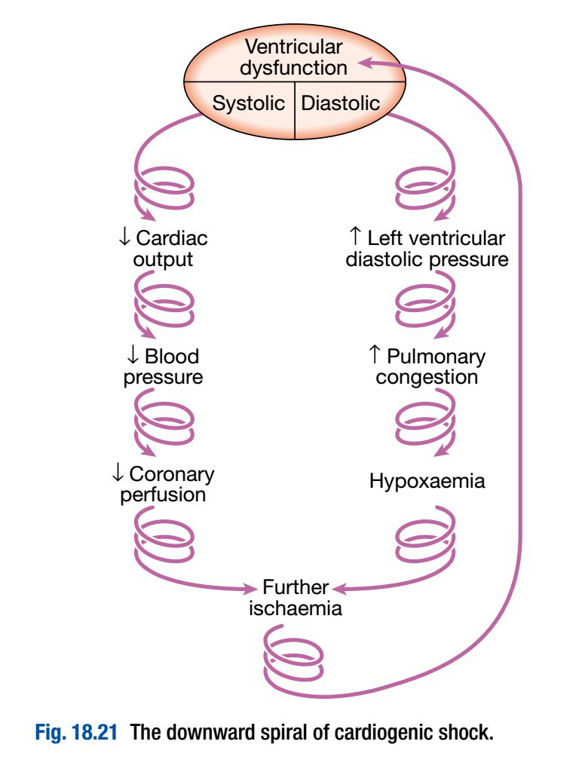
These factors combine to create the ‘downward spiral’ of cardiogenic shock:

Slide 63
Hypotension, oliguria, confusion and cold clammy peripheries are the manifestations of a low cardiac output, whereas breathlessness, hypoxaemia, cyanosis and inspiratory crackles at the lung bases are typical features of pulmonary oedema.

Slide 64
A chest X-ray may reveal signs of pulmonary congestion when clinical examination is normal.
If necessary, a Swan–Ganz catheter can be used to measure the pulmonary artery wedge pressure to guide fluid replacement.

Slide 65
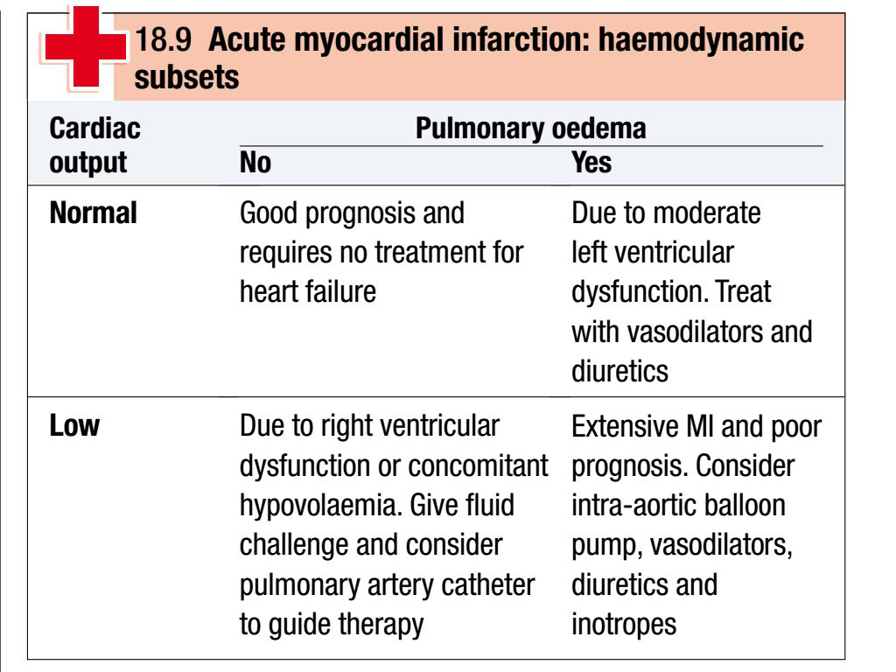
The findings can be used to categorise patients with acute MI into four haemodynamic subsets:

Slide 66
Those with cardiogenic shock should be considered for immediate intra-aortic balloon counterpulsation and coronary revascularisation.

Slide 67
The viable myocardium surrounding a fresh infarct may contract poorly for a few days and then recover.
This phenomenon is known as myocardial stunning and means that acute heart failure should be treated intensively because overall cardiac function may subsequently improve.

Slide 68
-Acute massive pulmonary embolism:
This may complicate leg or pelvic vein thrombosis and usually presents with sudden collapse.
Bedside echocardiography may demonstrate a small underfilled vigorous LV with a dilated RV; it is sometimes possible to see thrombus in the right ventricular outflow tract or main pulmonary artery.
CT pulmonary angiography usually provides a definitive diagnosis.

Slide 69
-Cardiac tamponade:
This is due to a collection of fluid or blood in the pericardial sac, compressing the heart; the effusion may be small and is sometimes < 100mL.
Sudden deterioration may be due to bleeding into the pericardial space.

Slide 70
Tamponade may complicate any form of pericarditis but can be due to malignant disease.
Other causes include trauma and rupture of the free wall of the myocardium following MI.

Slide 71
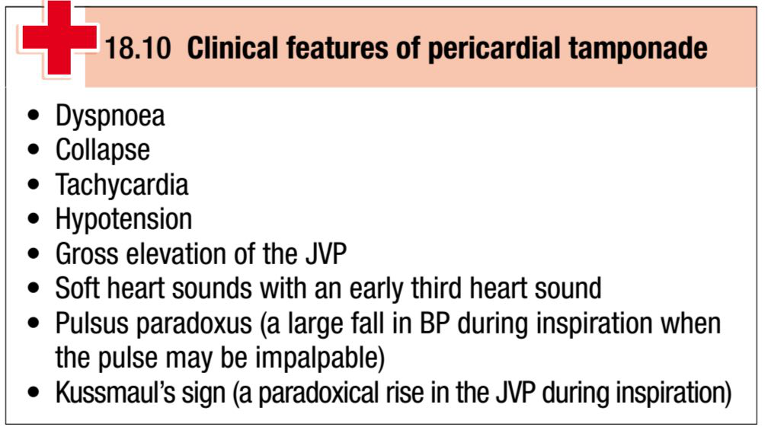

Slide 72
An ECG may show features of the underlying disease, such as pericarditis or acute MI.
When there is a large pericardial effusion, the ECG complexes are small and there may be electrical alternans: a changing axis with alternate beats caused by the heart swinging from side to side in the pericardial fluid.

Slide 73
A chest X-ray shows an enlarged globular heart but can look normal.
Echocardiography is the best way of confirming the diagnosis and helps to identify the optimum site for aspiration of the fluid.

Slide 74
Prompt recognition of tamponade is important because the patient usually responds dramatically to percutaneous pericardiocentesis or surgical drainage.

Slide 75
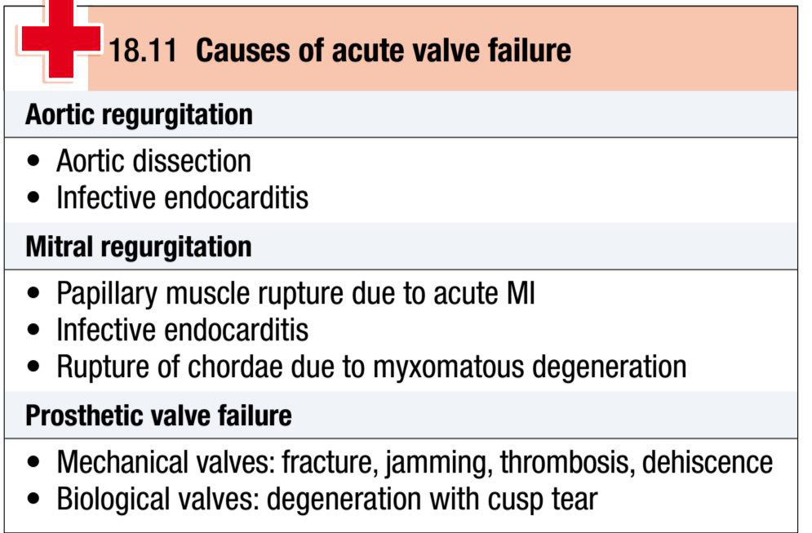
-Valvular heart disease:
Acute left ventricular failure and shock may be due to the sudden onset of aortic regurgitation, mitral regurgitation or prosthetic valve dysfunction.

Slide 76
The clinical diagnosis of acute valvular dysfunction is sometimes difficult.
Murmurs are often unimpressive because there is usually a tachycardia and a low cardiac output.

Slide 77
Transthoracic echocardiography will establish the diagnosis in most cases; however, transoesophageal echocardiography is sometimes required, especially in patients with prosthetic mitral valves.

Slide 78
Patients with acute valve failure usually require cardiac surgery and should be referred for urgent assessment in a cardiac centre.
Aortic dissection may lead to shock by causing aortic regurgitation, coronary dissection, tamponade or blood loss.

